Slide 1
UNIT II
AIRPLANE CONTROL SYSTEMS

Slide 2
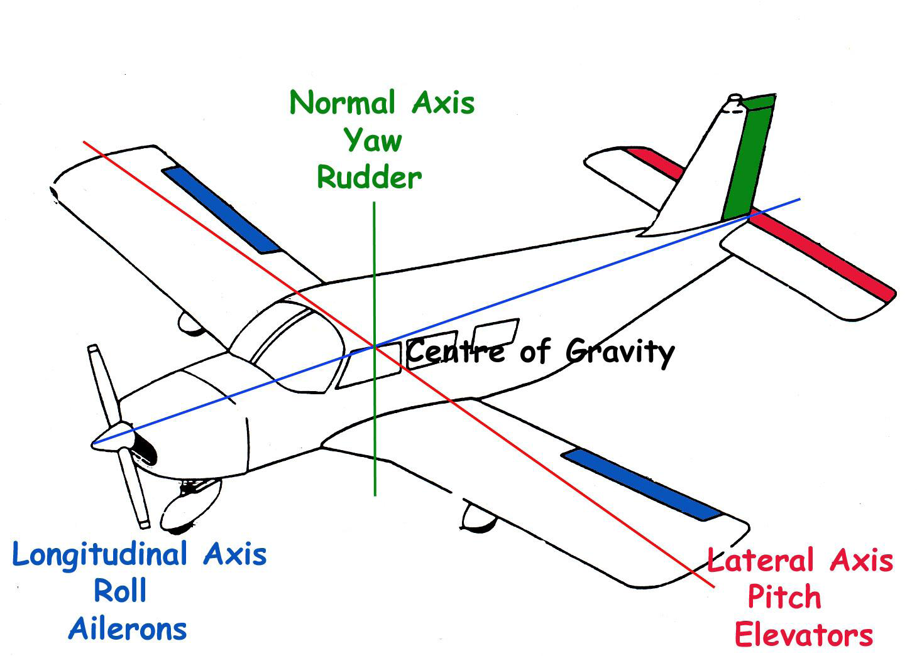
AXES OF CONTROL

Slide 3
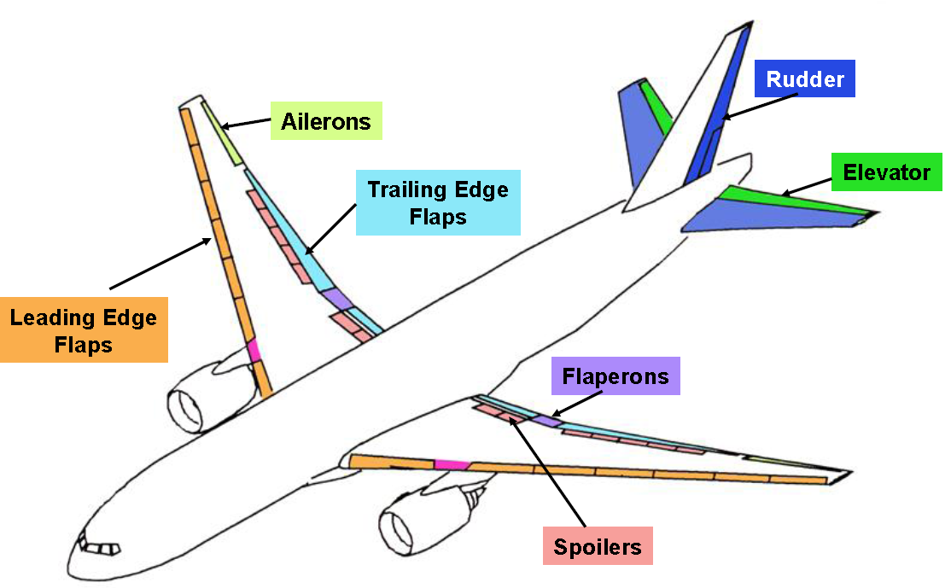
CONTROL SURFACES

Slide 4
BASIC FLIGHT CONTROL SYSTEMS
The movement of the flying control surfaces in response to the movement of the cockpit controls can be achieved in three ground ways:
mechanically, where interconnection of the control surfaces and the cockpit controls is resolved directly by a system of cables, rods, levers and chains
hydraulically, where the hydraulic power is necessary for the control surfaces to be moved.
The control valve may be operated electrically, where an electrical signal is sent from the cockpit control to the control surface to provide for movement.
The particular movement can be achieved hydraulically.

Slide 5
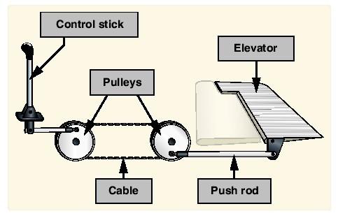
Mechanical flight control system

Slide 6
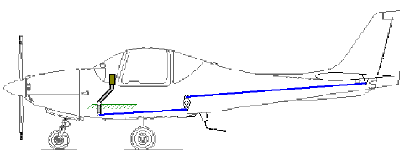
Push Pull Rod System for Elevator Control

Slide 7
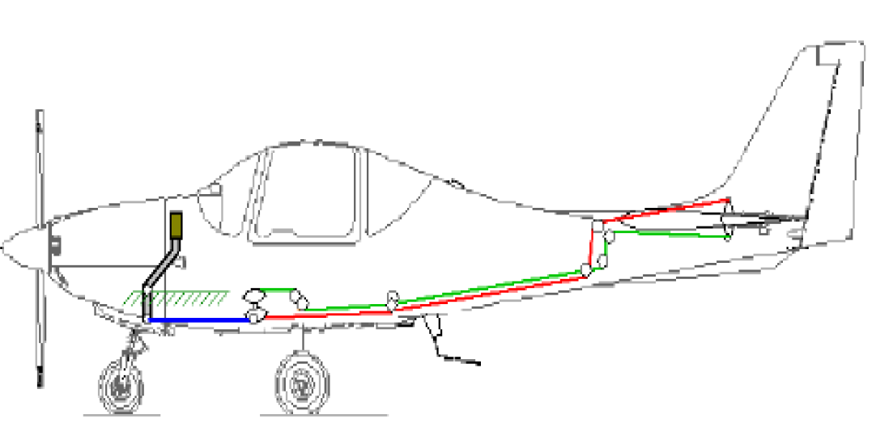
Cables & Pulleys System for Elevator Control

Slide 8
Basic Principle of Fully Manual Control System
A manual flight control system uses a collection of mechanical parts such as:
pushrods,
tension cables,
pulleys, counterweights,
sometimes chains to transmit the forces applied to the cockpit
controls directly to the control surfaces.

Slide 9
Need for Powered Control System
The Complexity and Weight of the system (Mechanical) increased with Size and Performance of the aircraft.
When the pilot’s action is not directly sufficient for the control, the main option is a powered system that assists the pilot.
The hydraulic system has demonstrated to be a more suitable solution for actuation in terms of reliability, safety, weight per unit power and flexibility, with respect to the electrical system.

Slide 10
The pilot, via the cabin components, sends a signal, or demand, to a valve that opens ports through which high pressure hydraulic fluid flows and operates one or more actuators.
The valve, that is located near the actuators, can be signalled in two different ways: mechanically or electrically
Mechanical signalling is obtained by push-pull rods, or more commonly by cables and pulleys
Electrical signalling is a solution of more modern and sophisticated vehicles

Slide 11
The basic principle of the hydraulic control is simple, but two aspects must be noticed when a powered control is introduced:
The system must control the surface in a proportional way, i.e. the surface response (deflection) must be function to the pilot’s demand (stick deflection, for instance)
The pilot that with little effort acts on a control valve must have a feedback on the maneuver intensity

Slide 12
The pilot, in normal hydraulic operating conditions, is requested for a very low effort, necessary to contrast the mechanical frictions of the linkage and the movement of the control valve
The pilot is then no more aware of the load condition being imposed to the aircraft.
An artificial feel is introduced in powered systems, acting directly on the cabin control stick or pedals

Slide 13
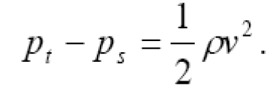
The simplest solution is a spring system, then responding to the pilot’s demand with a force proportional to the stick deflection; this solution has of course the limit to be not sensitive to the actual flight conditions.
A more sophisticated artificial feel is the so-called Q feel. This system receives data from the pitot-static probes, reading the dynamic pressure, or the difference between total (pt) and static (ps) pressure, that is proportional to the aircraft speed v through the air density ρ:

Slide 14
This signal is used to modulate a hydraulic cylinder that increases the stiffness in the artificial feel system, in such a way that the pilot is given a contrast force in the pedals or stick that is also proportional to the aircraft speed.

Slide 15
Disadvantages of Mechanical and Hydro-Mechanical Systems
Heavy and require careful routing of flight control cables through the aircraft using pulleys, cranks, tension cables and hydraulic pipes.
They require redundant backup to deal with failures, which again increases weight.
Limited ability to compensate for changing aerodynamic conditions
Dangerous characteristics such as stalling, spinning and pilot-induced oscillation (PIO), which depend mainly on the stability and structure of the aircraft concerned rather than the control system itself, can still occur with these systems

Slide 16
By using electrical control circuits combined with computers, designers can save weight, improve reliability, and use the computers to mitigate the undesirable characteristics mentioned above.
Modern advanced fly-by-wire systems are also used to control unstable fighter aircraft.

Slide 17
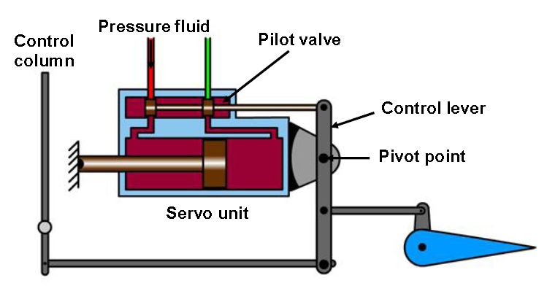
POWER ASSISTED & POWER OPERATED
Power Assisted
Movement of the control column will move both the flying control and the pilot valve Reversible controls.

Slide 18
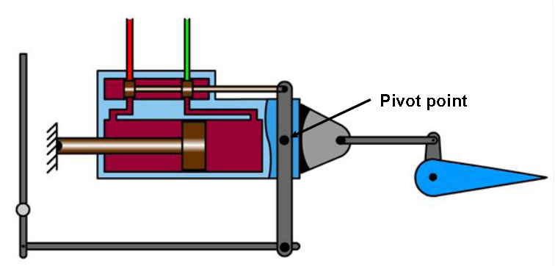
Power Operated
Movement of the control column only moves the pilot valve.
Irreversible controls

Slide 19
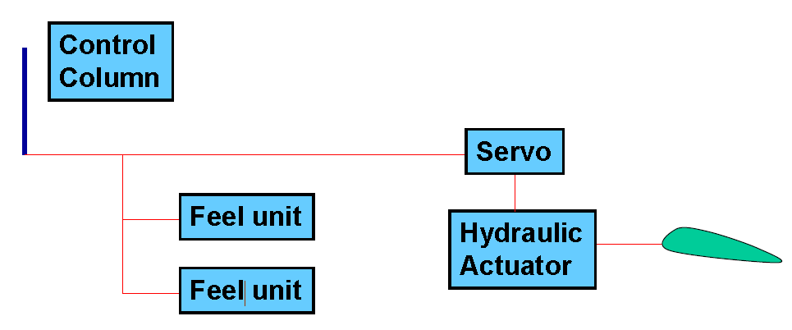
ARTIFICIAL FEEL (Q-FEEL)
Artificial feel systems are designed to increase control column/rudder pedal forces to reflect increases in:-IAS (q) by sensing dynamic pressure-Control deflection in order to reduce the chance of overstressing the aircraft
Normally duplicated and fitted in parallel with the control runs

Slide 20
FBW – Introduction
The FBW architecture was developed in 1970’s
Initially starting as an analogue technique and later on transformed into digital.
It was first developed for military aviation, where it is now a common solution
The supersonic Concorde can be considered a first and isolated civil aircraft equipped with a (analogue) fly-by-wire system
In the 80’s the digital technique was imported from military into civil aviation by Airbus, first with the A320, then followed by A319, A321, A330, A340, Boeing 777 and A380 (scheduled for 2005).
This architecture is based on computer signal processing.

Slide 21
ANALOG FLYBYWIRE
The control mechanisms in the cockpit now operate signal transducers, which in turn generate the appropriate electronic commands.
These are next processed by an electronic controller with an analog signal.
DIGITAL FLYBYWIRE
A digital fly-by-wire flight control system is similar to its analog counterpart.
The signal processing is done by digital computers and the pilot literally can "fly-via-computer". It increases the flexibility of the flight control system.

Slide 22
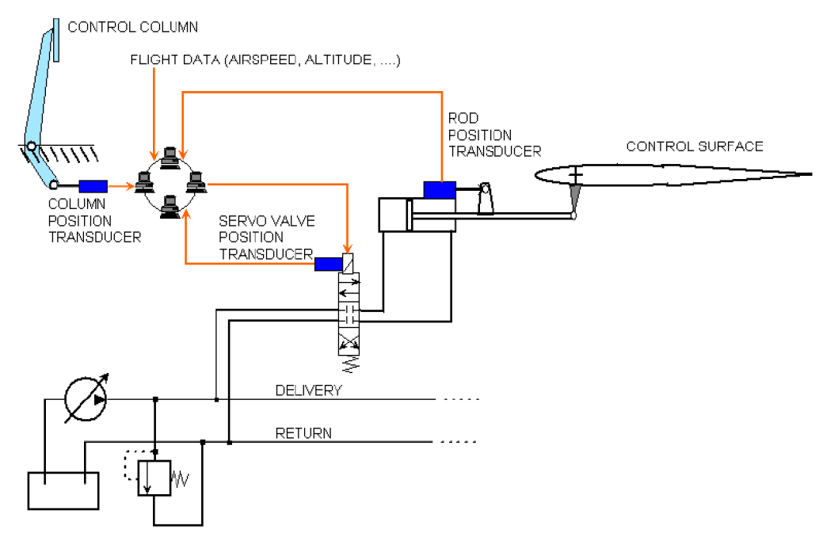
Fly by wire system

Slide 23
The pilot’s demand is first of all transduced into electrical signal in the cabin and sent to a group of independent computers (Airbus architecture substitute the cabin control column with a side stick)
The computers sample also data concerning the flight conditions and servo-valves and actuators positions
The pilot’s demand is then processed and sent to the actuator, properly tailored to the actual flight status.

Slide 24
The flight data used by the system mainly depend on the aircraft category; in general the following data are sampled and processed:
– pitch, roll, yaw rate and linear accelerations
– Angle of attack and sideslip
– Airspeed/Mach number, Pressure, Altitude and radio altimeter indications
–Stick and pedal demands
–Other cabin commands such as landing gear condition, thrust lever position, etc.
The full system has high redundancy to restore the level of reliability of a mechanical or hydraulic system, in the form of multiple (triplex or quadruplex) parallel and independent lanes to generate and transmit the signals, and independent computers that process them.

Slide 25
FBW – Safety and Redundancy
Aircraft systems may be quadruplexed (four independent channels) in order to prevent loss of signals in the case of failure of one or even two channels.
Pre-flight safety checks of a fly-by-wire system are often performed using Built-In Test Equipment (BITE).
On programming the system, either by the pilot or ground crew, a number of control movement steps are automatically performed.
Any failure will be indicated to the crews .

Slide 26
FBW – Advantages
Flight envelope protection (the computers will reject and tune pilot’s demands that might exceed the airframe load factors).
Increase of stability and handling qualities across the full flight envelope, including the possibility of flying unstable vehicles.
Turbulence suppression and consequent decrease of fatigue loads and increase of passenger comfort.

Slide 27
Drag reduction by an optimized trim setting
Higher stability during release of tanks and weapons
Easier interfacing to auto-pilot and other automatic flight control systems
Weight reduction (mechanical linkages are substituted by wirings)
Maintenance reduction
Reduction of airlines’ pilot training costs (flight handling becomes very similar in an whole aircraft family)

Slide 28
Digital Fly-By-Wire (DFBW)
A digital fly-by-wire flight control system is similar to analog system. However, the signal processing is done by digital computers and the pilot literally can "fly-via-computer".
Increases in flexibility of the flight control system, since the digital computers can receive input from any aircraft sensor (such as the altimeters and the pitot tubes).
Increase in electronic stability - system is less dependent on the values of critical electrical components in an analog controller.

Slide 29
The computers "read" position and force inputs from the pilot's controls and aircraft sensors.
Aircraft designers precisely tailor an aircraft's handling characteristics, to stay within the overall limits of what is possible given the aerodynamics and structure of the aircraft.
Flight-control computers continuously "fly" the aircraft, pilot's workloads can be reduced.
Better maneuverability during combat and training flights and " carefree handling" because stalling, spinning. and other undesirable performances are prevented automatically by the computers.

Slide 30
Most of the early digital fly-by-wire aircraft also had an analog electrical, a mechanical, or a hydraulic back-up flight control system.
For airliners, flight-control redundancy improves their safety.
Fly-by-wire control systems also improve economy in flight because they are lighter, and they eliminate the need for many mechanical, and heavy, flight-control mechanisms.
Most modern airliners have computerized systems that control their jet engine throttles, air inlets, fuel storage and distribution system, in such a way to minimize their consumption of jet fuel.
Thus, digital control systems do their best to reduce the cost of flights.

Slide 31
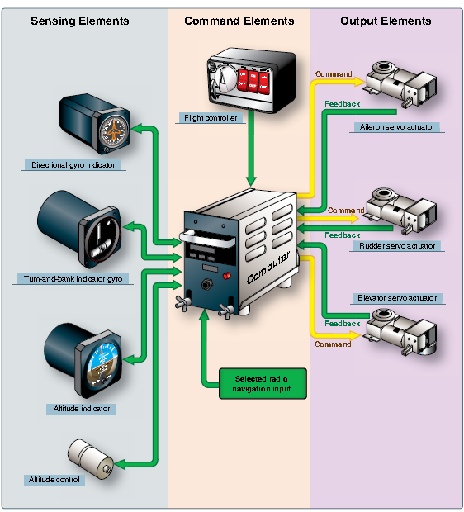
Autopilot system components

Slide 32
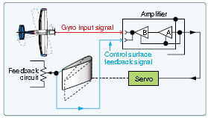
BASIC AUTOPILOT SYSTEM

Slide 33
